Slide 1


Team
Abhishek Pundhir (Backend + Database + App UI Structure )
Dheeraj Varlani ( Event Structure + Card Designe )
Manas Khatri ( Content + Database +
BCA / 6th Sem
Mentor - Dr Vineet Mishra

Slide 2
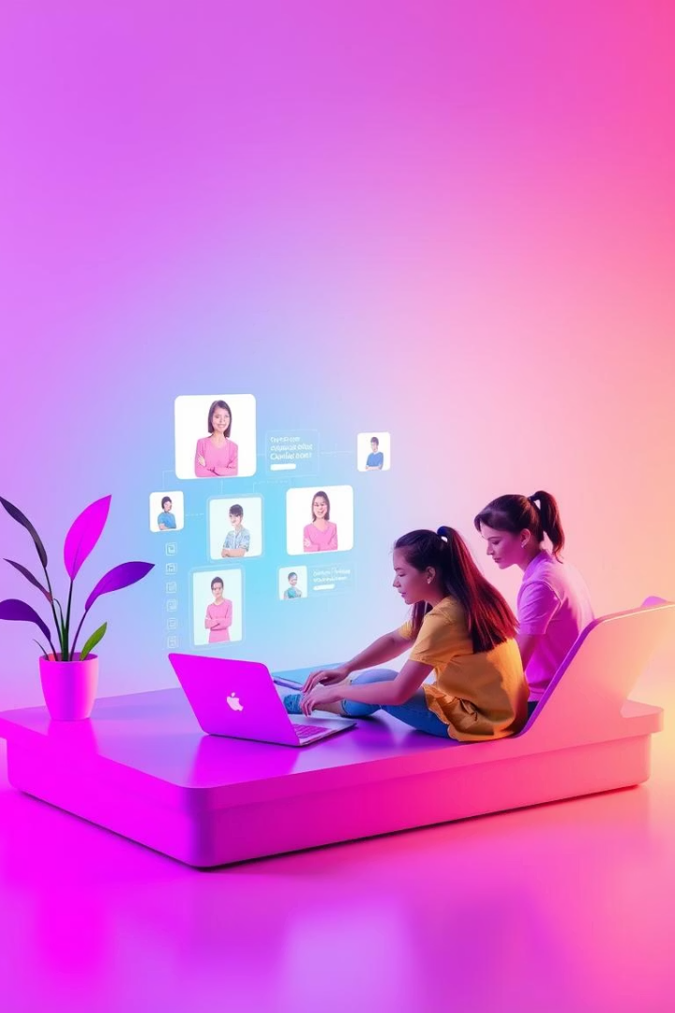
Vibespace.Com: Revolutionizing Student Collaboration
A web-based platform that allows college students to view and participate in faculty-organized hackathons without login, while enabling admins to manage and evaluate submissions seamlessly.

Slide 3

Problem Statement
1
Announcements
Hackathons are often announced via informal channels (WhatsApp, notice boards).
2
Lack of Centralized system
No centralized system to submit, manage, or evaluate student projects.
3
Use Complexity
Students hesitate to join due to complicated registration/login processes.
4
Faculty
Faculty struggle to track submissions and give structured feedback

Slide 4





Objective
Controle
Centralized platform for college hackathons.
Simplify Joining
Simplify event participation for students.
Efficiently Management
Allow faculty to efficiently manage and evaluate submissions.
Faire Feedback
Provide a fair and transparent approval system with feedback.

Slide 5
Vibespace Features - A Comprehensive Overview
Key Features
Students
Admin/Faculty
Event Listings
No login required
Login-based dashboard.
Team Formation
View events (upcoming/active/completed)
Create/update/delete events.
Project Submission
View and evaluate project submissions.
Collaborative Workflow
Submit projects with full details
Admin Panel
Easy to Use and understand.
Approve/reject with written feedback.
Team Building and Collaborative Environment

Slide 6
Admin Access - Special Access
1
HOD's
Dr Vineet Mishra , Mr Sunil Garg
2
IT Department
Jyoti Mam , Himanshi Mam
3
Management & Commerce Department
Anchal Mam , Swati Mam
4
Master Access
Artist
All administrators shall be provided with a username and password, which they may graciously amend according to their own preference.

Slide 7

Vibespace Mind Map: App Workflow
Visitor lands on home page —> Sees Events
Student clicks on an active event —> Fills project submission form
Admin logs In —> Views event panel → Reviews submissions
Admin approves/rejects —> With written feedback shown to students

Slide 8
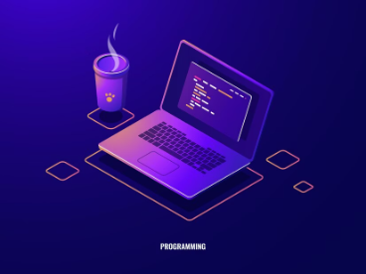



Tech Stack
Backend-End
Database
Deployment
Front-End
Node
Local Admin System
Version Controle
Shadcn-UI
TypeScript
Array
Netlify
Tailwind
JavaScript
Object
Git / GitHub
React
Vite

Slide 9

Why Use This App
Eliminates the need for student registration
Transparent feedback system from faculty
One-stop solution for hackathon management
Saves time for both students and faculty
Encourages innovation and participation on campus

Slide 10

Challenges Solved
Unorganized event announcements
Manual project collection
Lack of structured feedback
No tracking of project submissions or participants

Slide 11

Future Enhancements
Add student profile for tracking past submissions
Real-time leaderboard and ranking system
Certificate generation for approved projects
Team chat or discussion module
Push/email notifications for events and feedback updates
AI Bot to Chat and guide Teams About there progress Track and Project Ideas auto Submission + Auto checking and auto Feedback Generation about suggestions and improvements of the project.

Slide 12
Conclusion
A practical, user-friendly platform that bridges the gap between students and faculty in organizing and participating in hackathons.
Promotes technical skill-building and collaborative innovation in college.

Slide 13
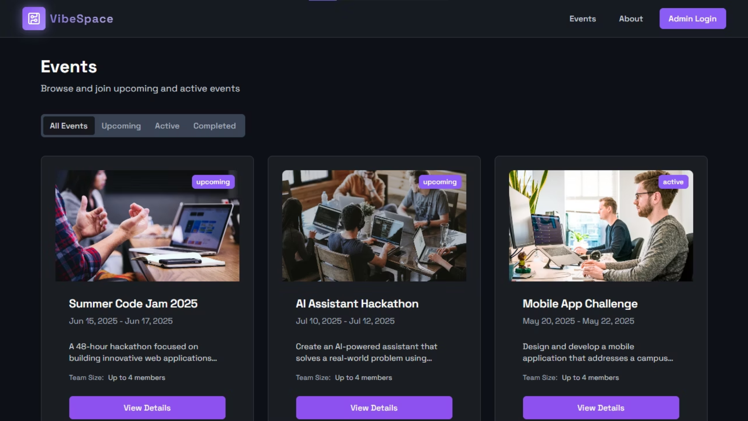
Demo Links
​GitHub Repository Link​​
Hosted Site Link :
https://vibespaceorg.netlify.app/​
Thank You ……..

